Slide 1
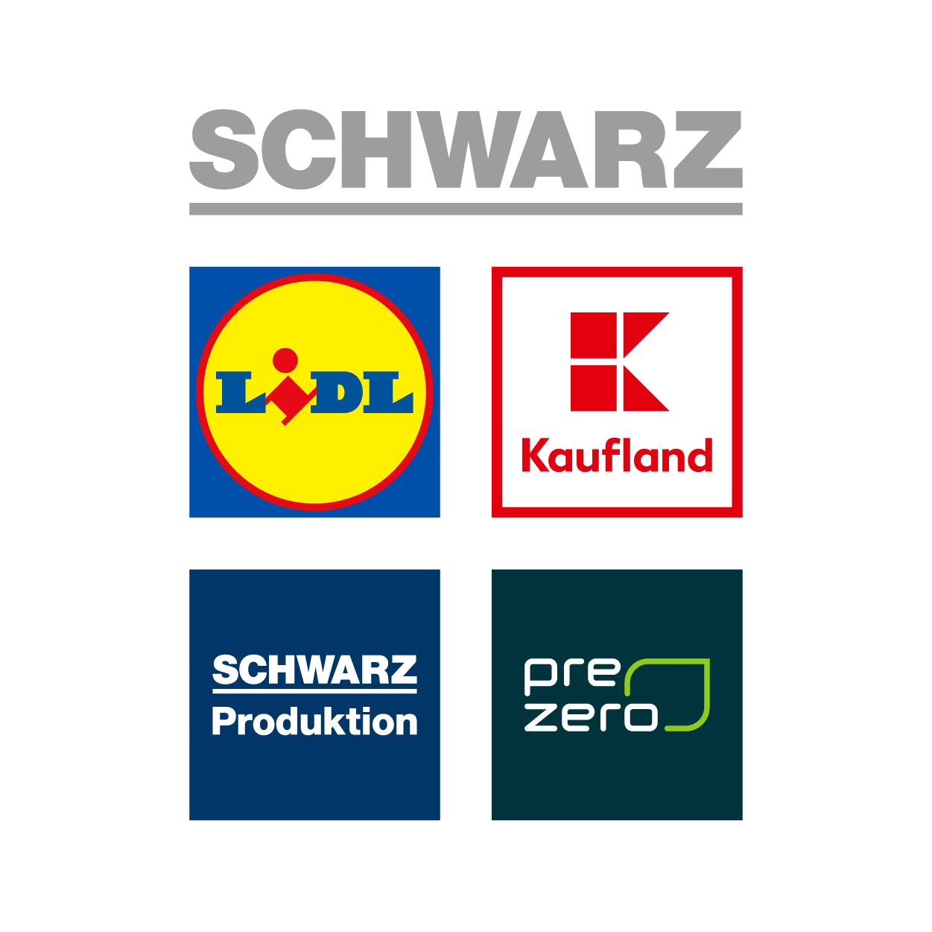
Schwarz it bulgaria
Sofia, 2021

Slide 2
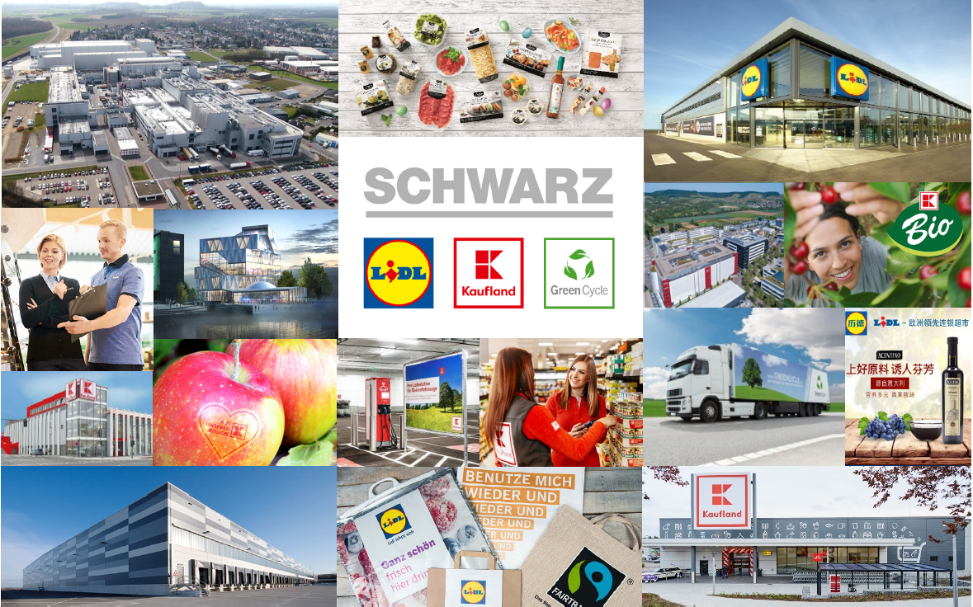
our business in the Making

Slide 3




Schwarz Group
We focus on the things that matter
Quality
High-quality
products, daily
Price
Top quality at unbeatable prices
Efficiency
Process pros with a system
and price edge
Responsibility
Economic, social and
ecological responsibility

Slide 4
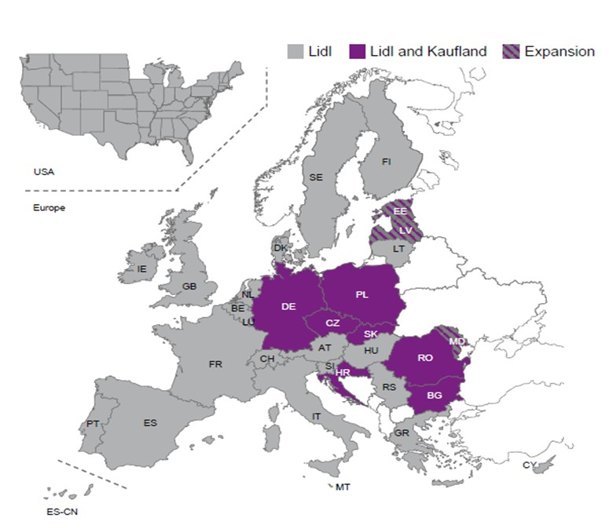
SCHWARZ GROUP
COUNTRIES OF OPERATIONS

Slide 5
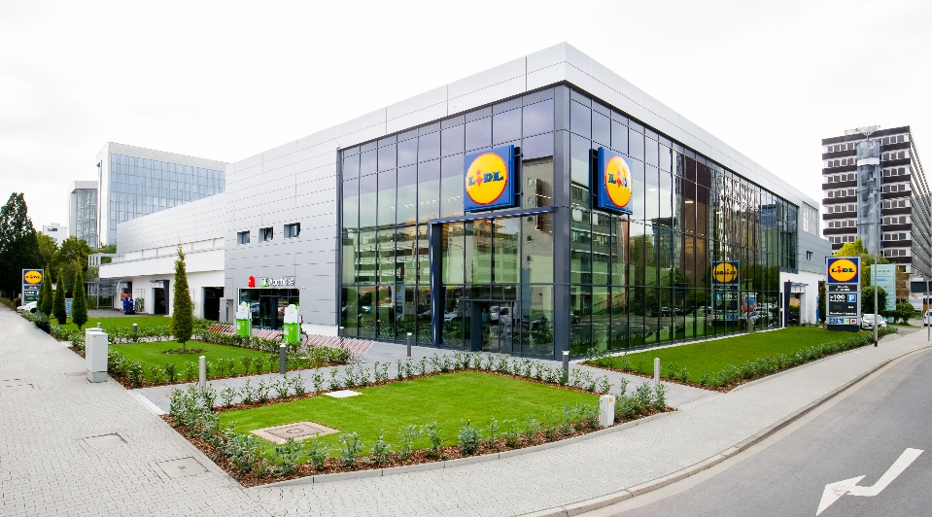


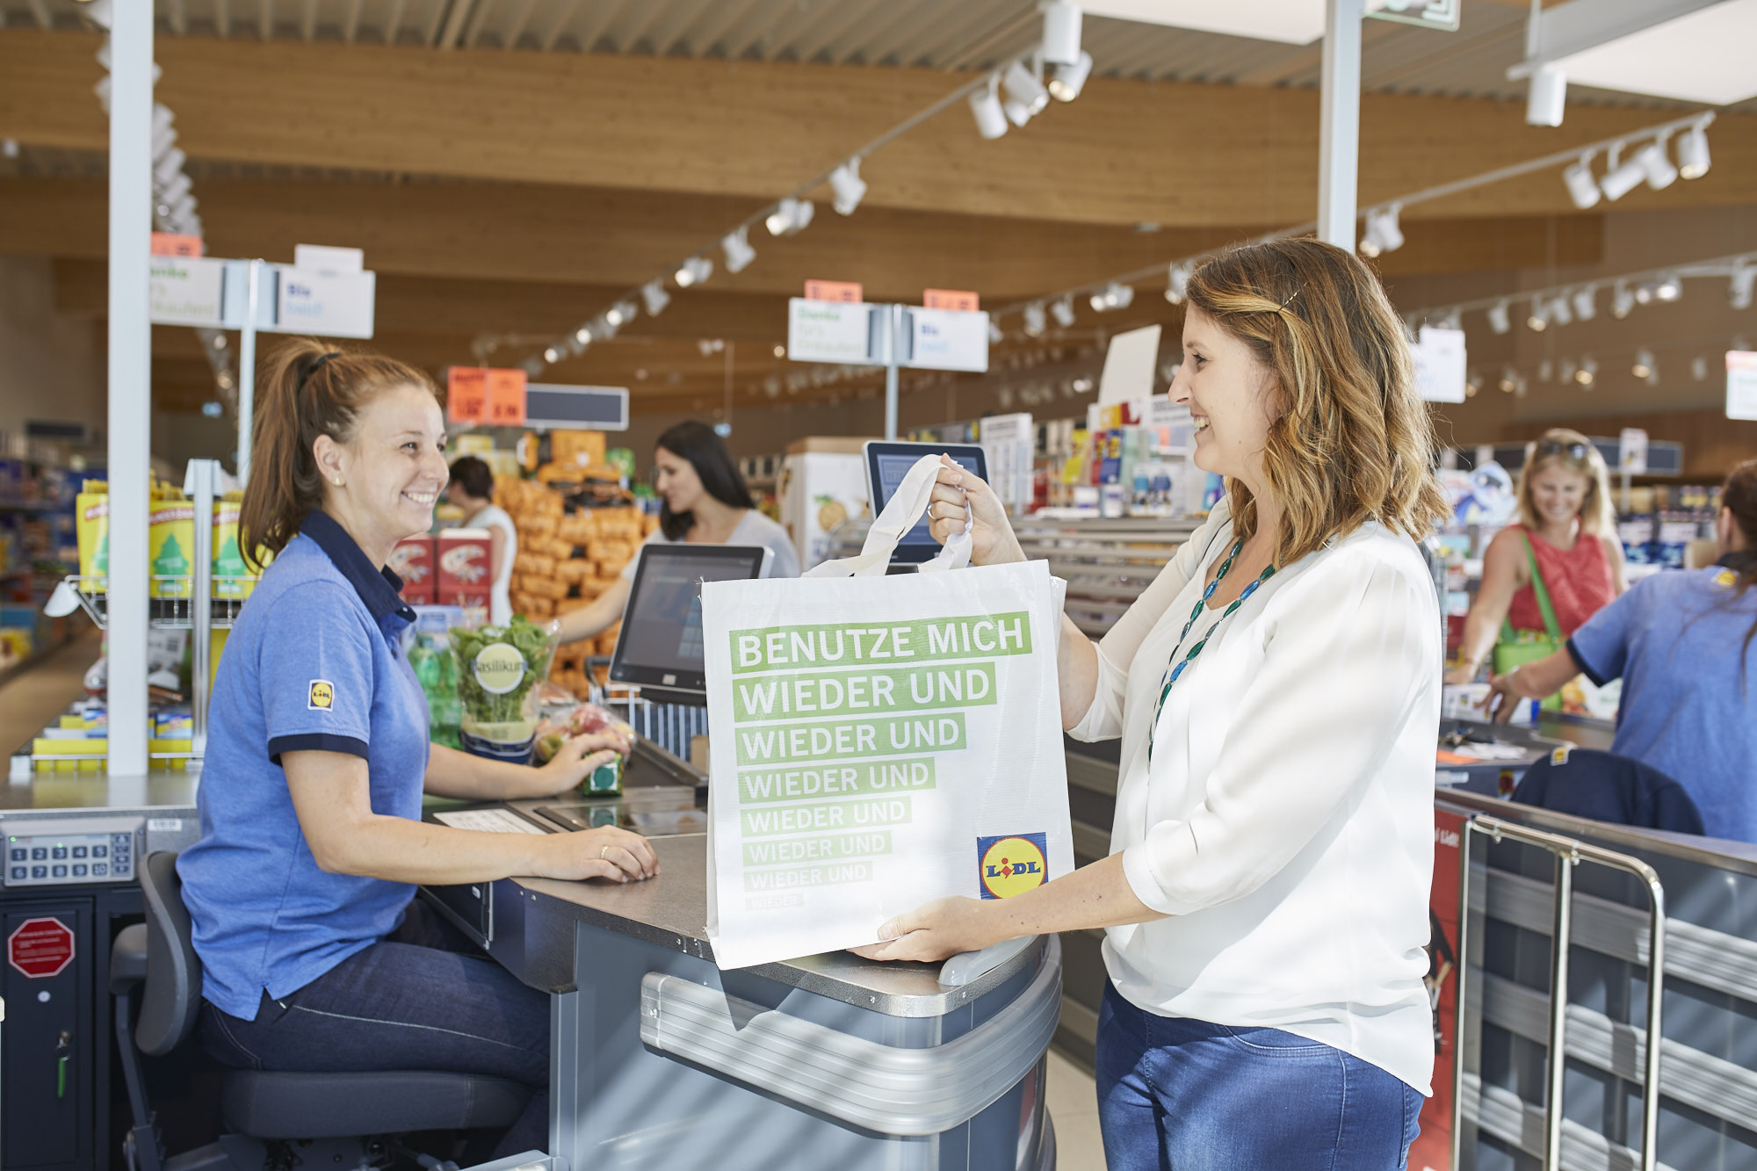
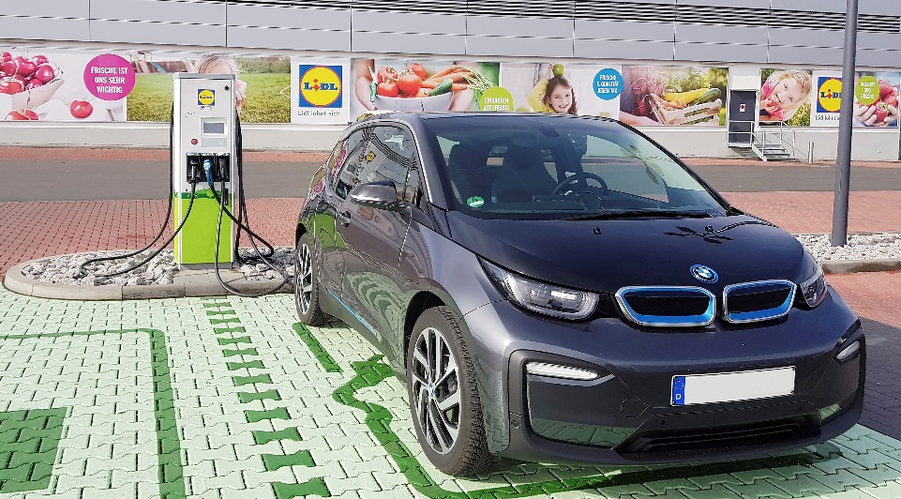

Lidl
Our discounter: Quality for everybody – at an unbeatable price
www.lidl.de

Slide 6
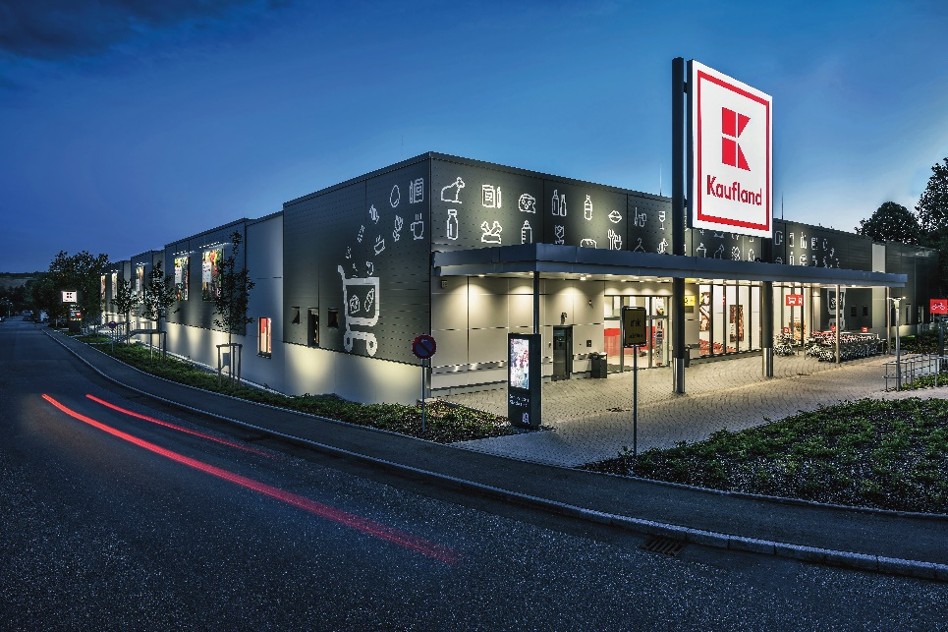
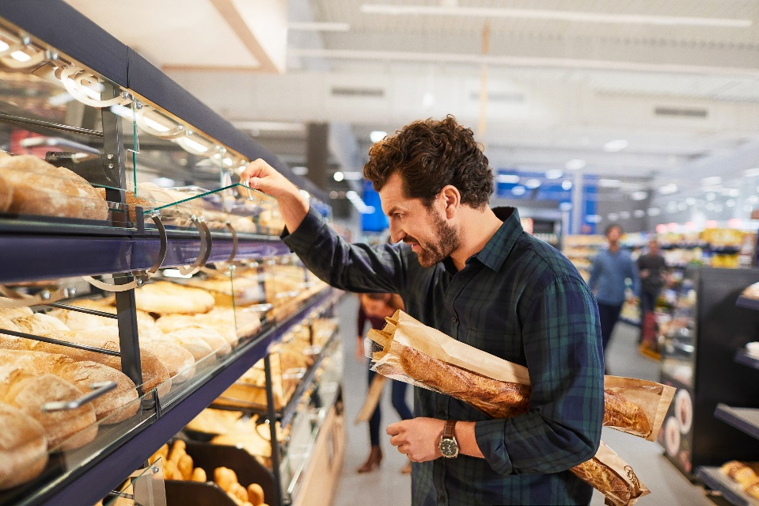

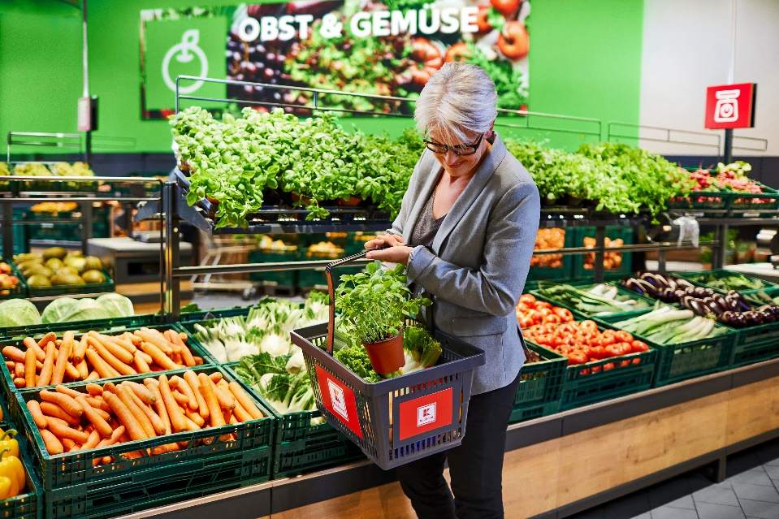
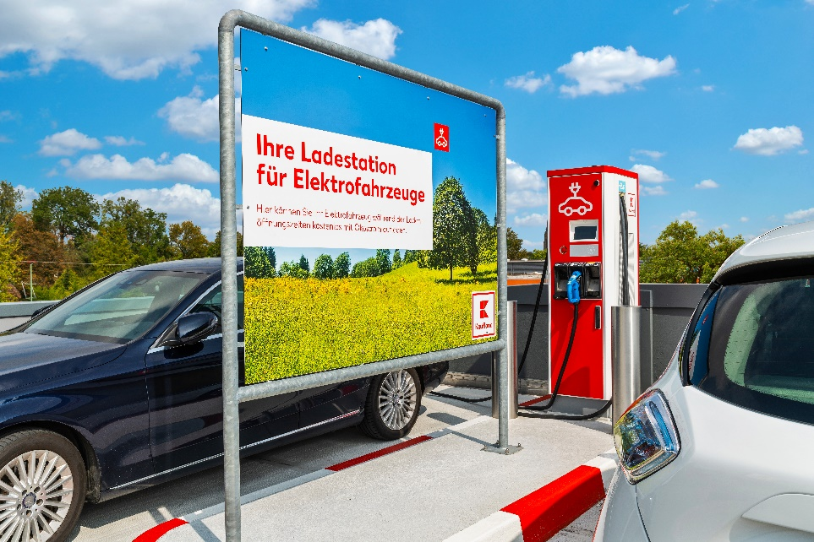
Kaufland
Our self-service department store: The perfect shopping experience
www.kaufland.de

Slide 7
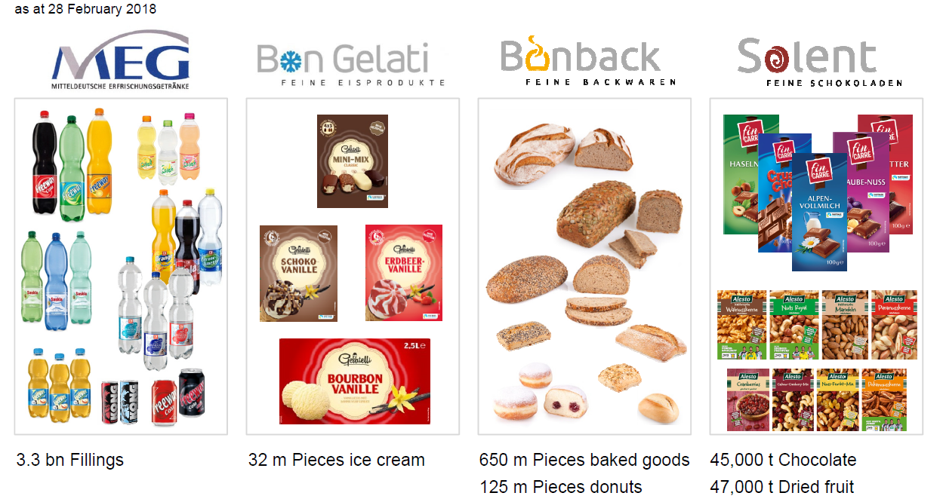
SCHWARZ GROUP
PRODUCTION

Slide 8
GreenCycle
The environmental branch
www.greencycle.de
Notes:
GC, alongside Lidl, KL and SDL/SZD, is also part of Schwarz Group
We are a global disposal company and a driver of innovation in the areas of recyclables and energy management, environmental innovation and logistics solutions.
The following represents figures, data and facts as of March 2020.

Slide 9
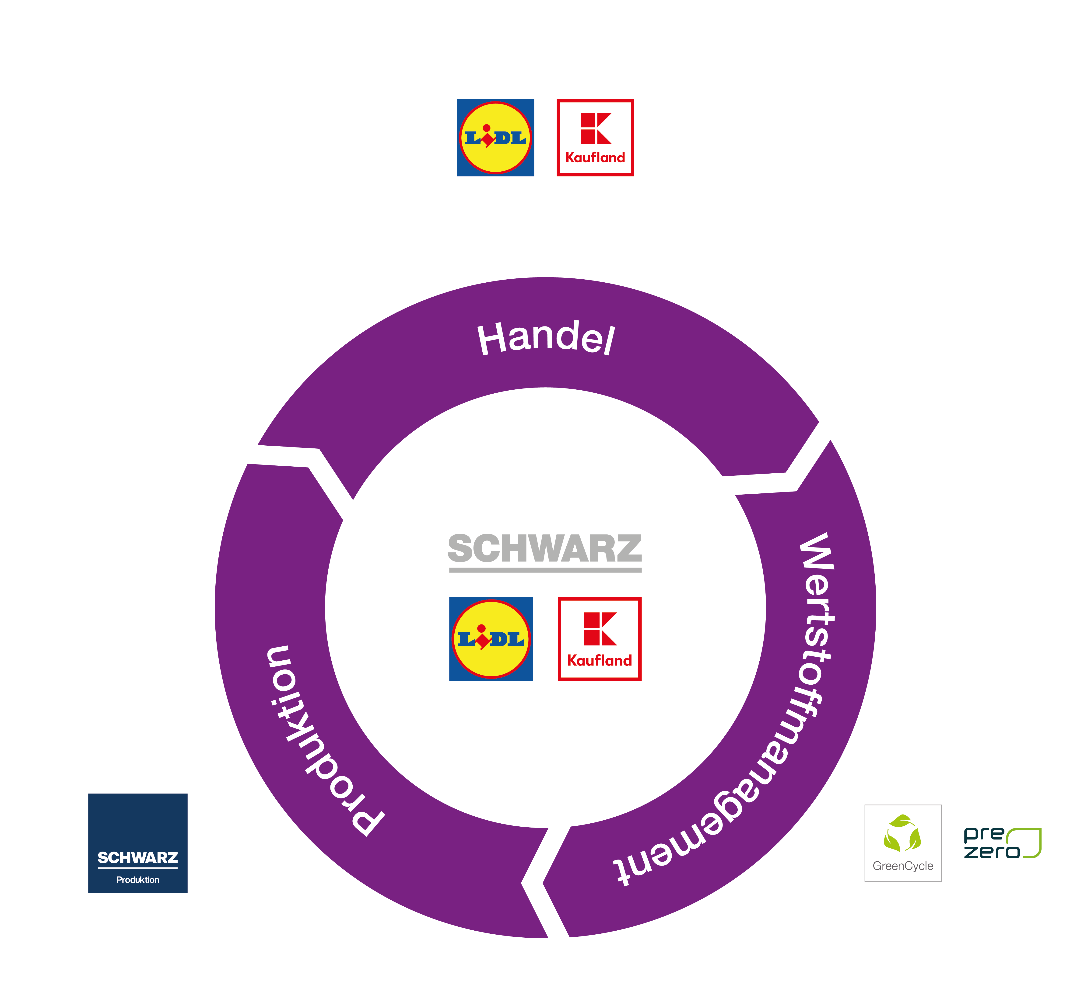

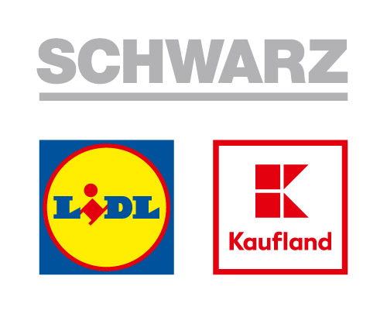

SCHWARZ GROUP
Schwarz Zentrale Dienste &
Schwarz Dienstleistungen
Retail
Recyclables management
Production

Slide 10
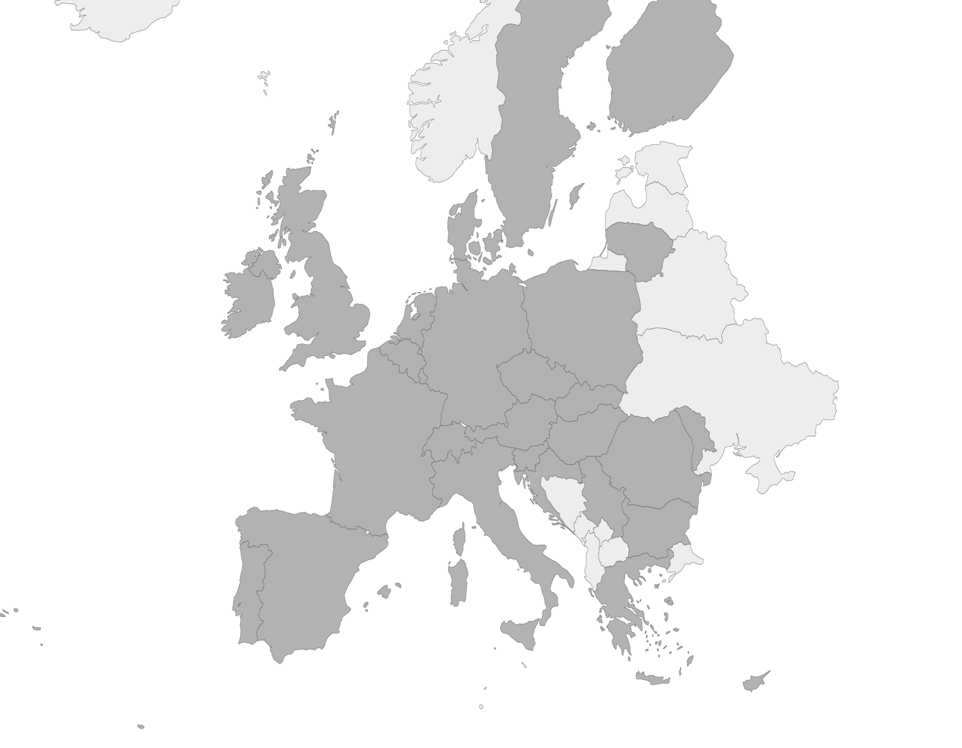
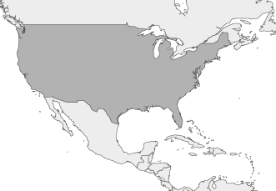




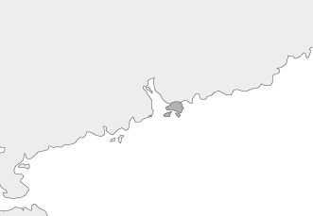



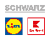





Our customers
Finland
We are the central IT service provider for...
USA
Estonia
Sweden
(expansion)
Latvia
(expansion)
Denmark
Lithuania
Northern Ireland
Hong Kong
Ireland
Great Britain
The Netherlands
Production
Retail
Poland
Belgium
Germany
Recyclable materials
Luxembourg
Neckarsulm
Czech Republic
Slovakia
Switzerland
Austria
Hungary
Moldova
France
Slovenia
Romania
>12, 100
30
30
>429,000
Stores
Sorting & recycling facilities
Countries
Employees
over 160,000 of them in DE
Croatia
Serbia
Italy
Bulgaria
Spain
Greece
Portugal
Malta
Republic of Cyprus
Notes:
Already shown in the first employee event in BG
We are the central IT service provider for the Schwarz Group. This means that we are responsible for the IT of the number four in global retail, with over 12,100 Lidl and Kaufland stores in more than 30 countries. We also provide IT support for the production facilities and our recycling company Greencycle with Prezero, who have over 30 sorting and recycling plants. In all, we take care of the IT for over 430,000 employees throughout the Group. That's who we are, the employees of Schwarz IT and all the local IT units in the Schwarz Group. All together, we are ONE IT.

Slide 11
We are the digital heartbeat of THE SCHWARZ GROUP
Ownership
The best possible solution is in our hands!
Vision-driven
The best possible solution is one we create!
Values
Partnership
The best possible solution is one we develop together!
Solution-driven
Finding the best possible solution drives us forward!
Enthusiasm
We have fun working out the best possible solution!
Notes:
We enable the business though IT solutions

Slide 12
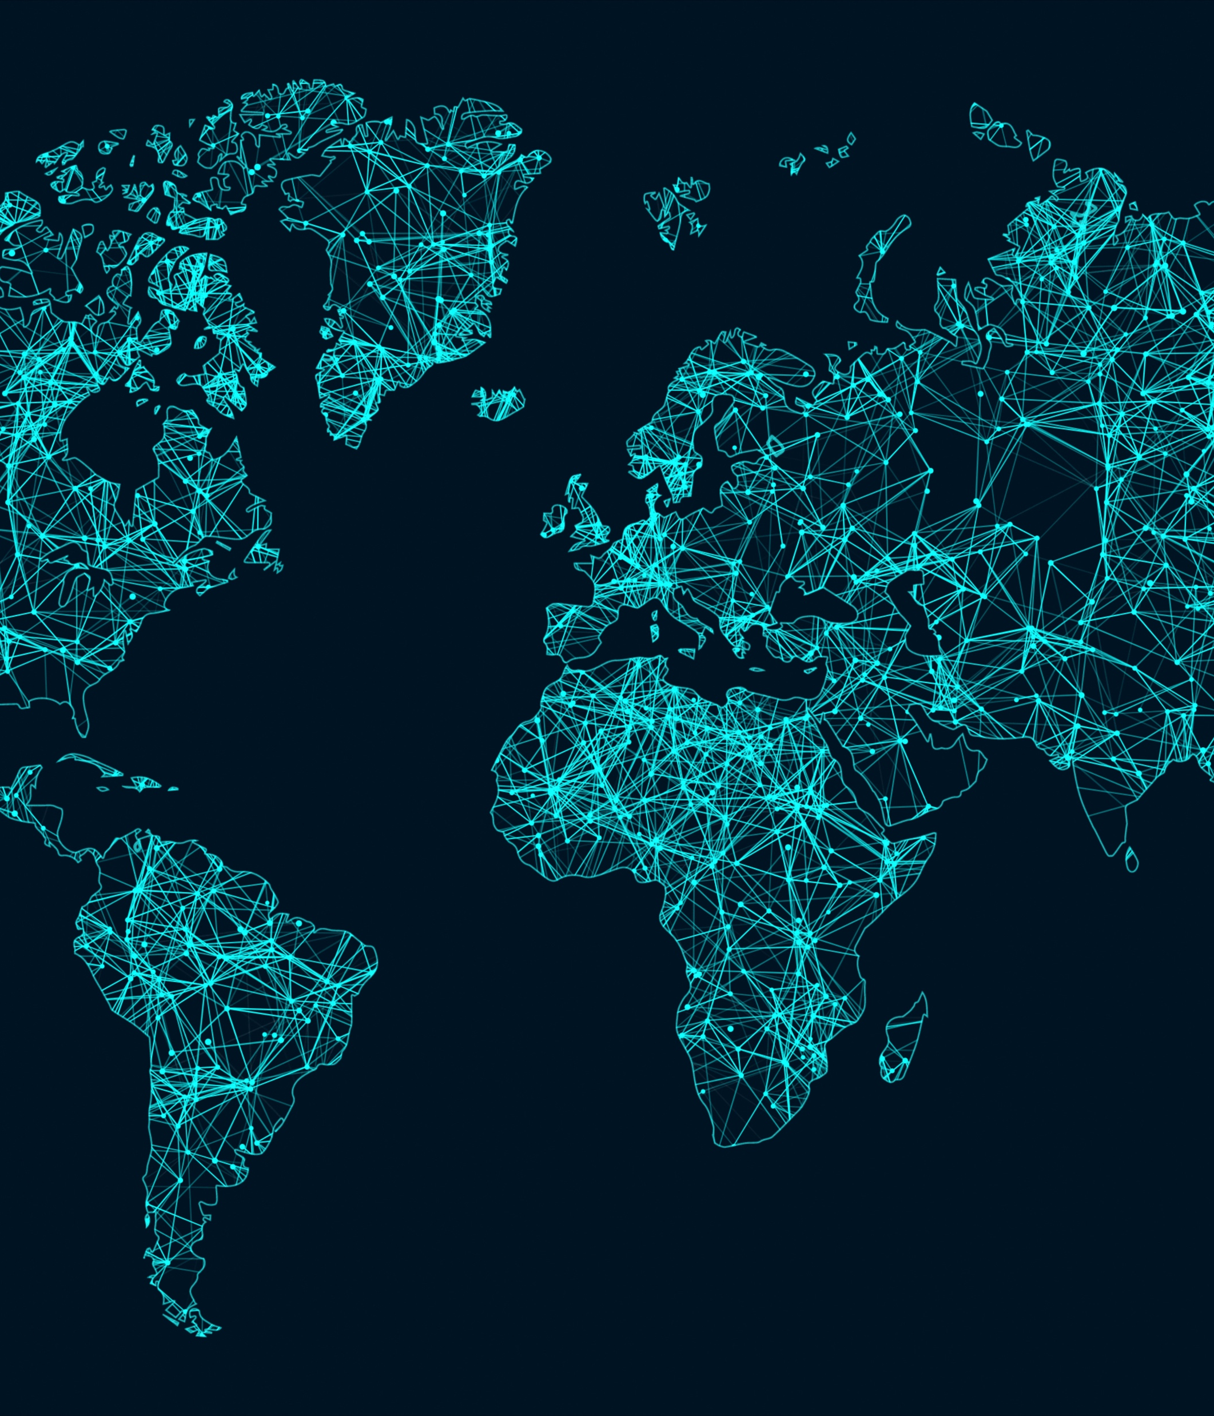
Expanding project base
Mobile development
Web development
Custom retail software
Wide range SAP module support
Internal cloud development
Data science and engineering

Slide 13
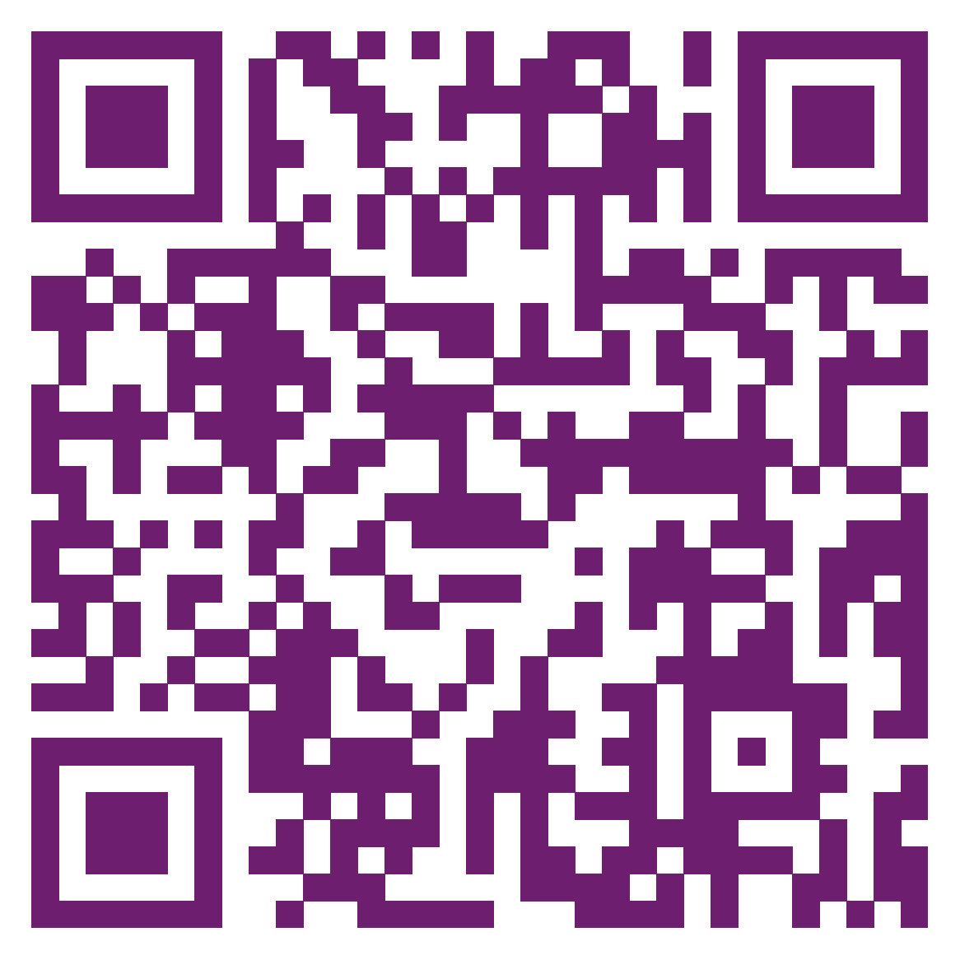
Join our lines!
https://bg.it.schwarz
https://www.jobs.bg/company/291782
https://www.facebook.com/schwarzitbg/
https://dev.bg/company/schwarz-it-bulgaria/
https://www.linkedin.com/company/schwarz-it-bulgaria/mycompany/

Slide 14

Thank you

